Slide 1
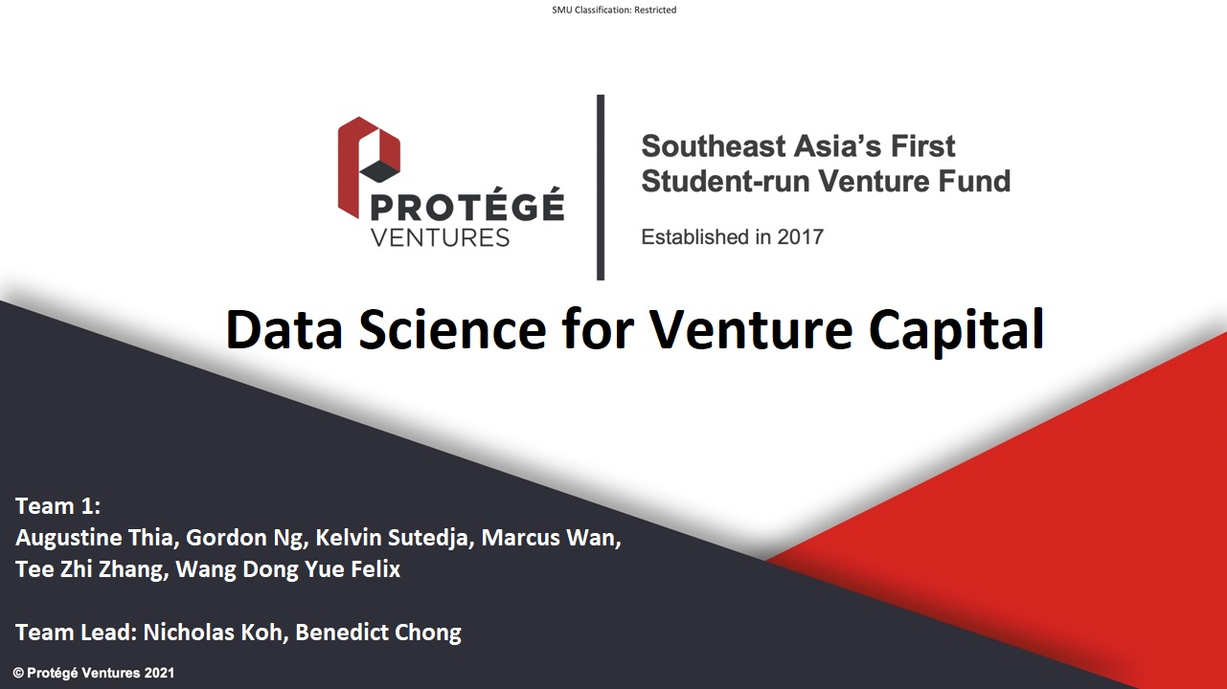
Data Science and Analytics
in Venture Capital
Notes:
Slide 1: Introductions
We’re Team 1, and today we will be going through on the topic of Data Science and Analytics in Venture Capital.
So before beginning, the reason why we, or at least, I, decided on this topic was because of our venture sessions, it seems to be highly based on intuition and “i feel”, “i think”, and often times i would think that there has got to be some way to automate this and give a rough probability of chances of failure of a startup based on some metrics right, rather than just “i dont think its good”. So anyways we decided to investigate if VC operations can be improved through data science and analytics, basically technology.

Slide 2
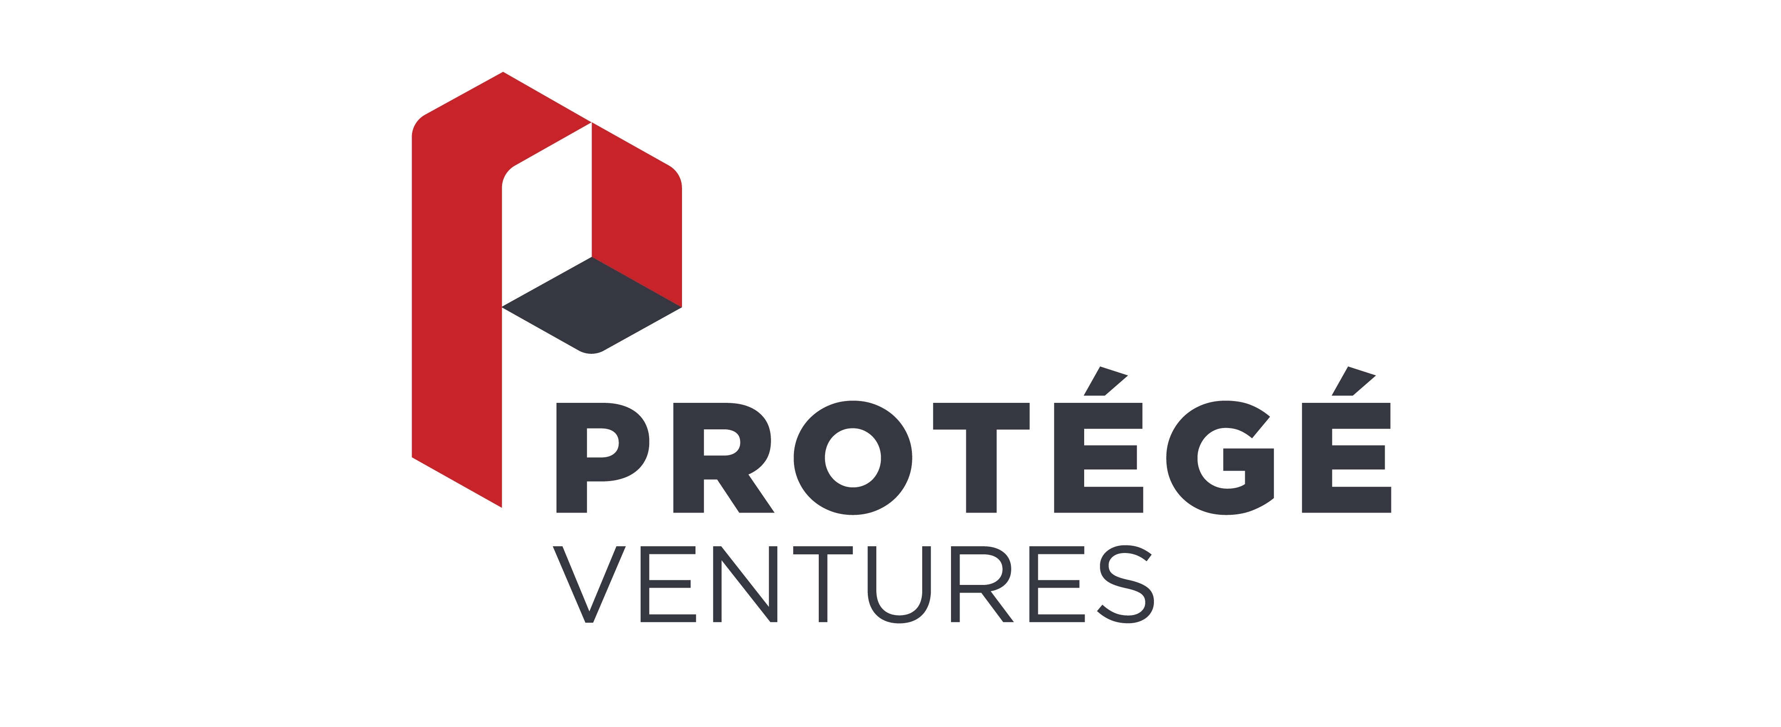
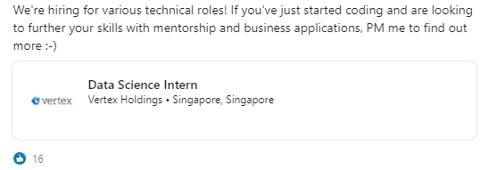
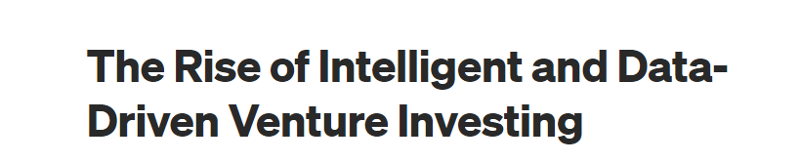
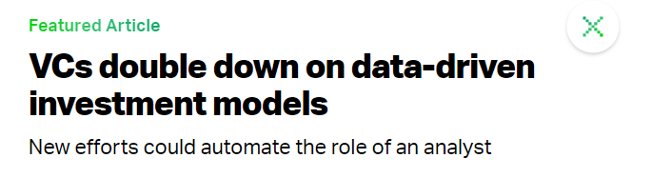
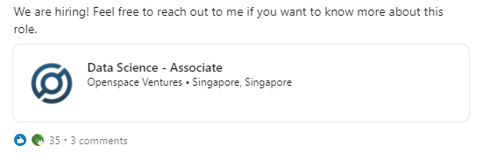
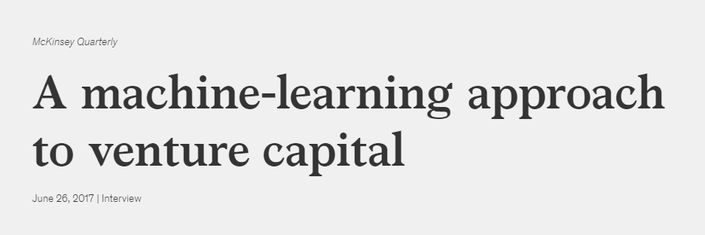
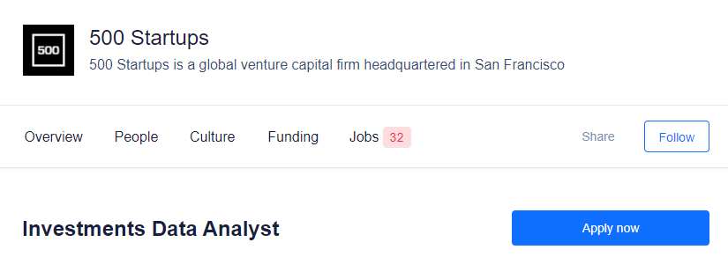
The Rise of Technology Adoption in VC
Increasing amount of VC firms in SEA opening up data science and analytics arms…
And usage of data science and analytics is gaining popularity in mainstream media
Introduction | Deal Sourcing | Deal Scoring | Portfolio Support | Fund Operations | Recommendations
Notes:
Slide 2: The Rise of Technology Adoption in VC
So there is the rise of technology adoption in VCs in a lot of areas, and we are especially starting to see the rise of technology adoption in SEA as well. Vertex, Openspace, and 500 Startups are all examples of VCs in SEA that are actively hiring for data scientists. I would know I cocked up my interview for Vertex.
So anyways we also see technology adoption becoming more mainstream in the news as well, you have many websites covering the topic in the past two years, and there has been more and more research into the topic if you judge by citations, research output, etc.

Slide 3




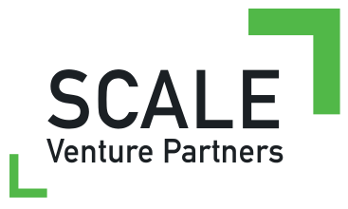





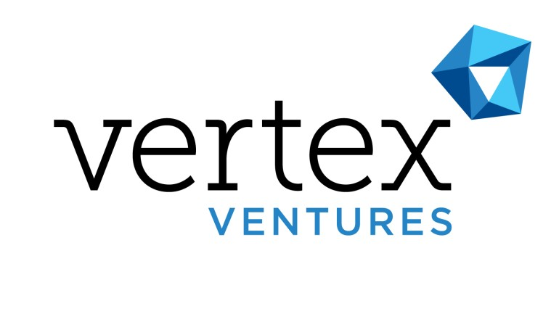
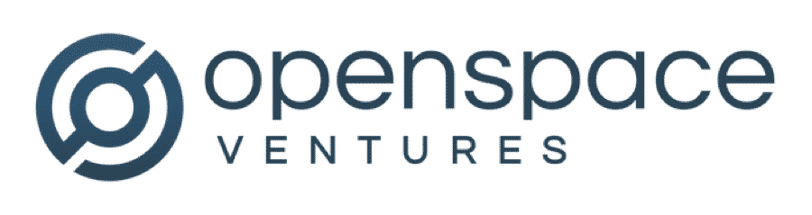


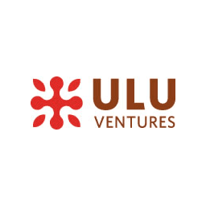



The Rise of Technology Adoption in VC
Introduction | Deal Sourcing | Deal Scoring | Portfolio Support | Fund Operations | Recommendations
Notes:
Slide 3: Examples of VCs
So as you see here, there are quite a few VCs out there, globally and regionally, that have been exploring the usage of data science. List not exhaustive.

Slide 4

How Data Science and Analytics can aid VCs
Notes:
Slide 4: Cover Slide
So now that we know that data science and analytics is not some future vision but is actively being implemented by firms throughout the world, let’s see exactly how technology can value-add to the VC process.

Slide 5
Breakdown of VC Operations
Operations |  | General Description |  | Potential Bottlenecks
Marketing/ Fundraising |  | Raising funds from investors and developing outreach of fund |  | Difficulty in raising funds from LPs
Investor Relations |  | Regular meetings with investors and managing information to them |  | Bogged down by content creation, documentations, and meetings
Deal Flow Generation |  | Sourcing for start-ups, building pipeline and due diligence for start-ups |  | How to increase higher-quality deal flow and accurately screen them
Portfolio Support |  | Introductions, interviewing job candidates, general business and strategic advice |  | Inability to significantly value add to portfolio companies
Finance and Back Office |  | Fund administration, fund compliance, financial reporting |  | May be bogged down by administrative challenges and delays
Introduction | Deal Sourcing | Deal Scoring | Portfolio Support | Fund Operations | Recommendations
Notes:
Slide 5: Breakdown of VC Operations
Ok so does anyone want to try and answer this. What are some components of a typical vc fund operation? (Ask Question)
Ok so these are some operations that I have identified, the general description and the potential bottlenecks of each component. Here are some challenges that I roughly written, feel free to suggest other challenges that you have experienced in your internships or jobs.

Slide 6
Usage of Data Science and Analytics in VC Ops
Ways Data Science and Analytics can complement VC Firms:
Improving Deal Flow |  | Portfolio Support |  | Fundraising |  | Finance and Back Office
 |  |  |  |  |  | Investor Relations
Data mining to increase efficiency of deal sourcing |  | In-house data science teams can advise and assist portfolio startups |  | Currently and best solved using various automation and information management software
Machine learning in deal screening for judging success rates |  | Data science to assist startups with recruitment, fundraising, and others |  | Network analysis to increase network and reveal other LPs
We will briefly go through the technologies and case studies of deal flow, portfolio support and fundraising
Introduction | Deal Sourcing | Deal Scoring | Portfolio Support | Fund Operations | Recommendations
Notes:
Slide 6: Value-Adding in VC through Technology
Here we actually identify that finance and back office and investor relations can actually be best solved through automation and various management software, like CRM, etc, that everyone already uses. Instead, we choose to focus on the other 3 verticals where data science seems to be able to value-add.
So here, Marcus, Gordon and Kelvin will go through deal flow, and we have split deal flow into deal sourcing and deal screening. Augustine and Zhi Zhang will go through portfolio support, and I will go through about fundraising. Lastly, we will wrap up with some general thoughts about technology adoption in VC and possible recommendations for PV. Cheers.

Slide 7
Data Science and Analytics for Deal Sourcing

Slide 8
Deal sourcing
Digital Footprint
First level
Second level
Third level
Twitter
Facebook
Web traffic
App store rankings
Web scraping/ data crawling
Identification of keywords or phrases that express positive or negative sentiments
Sourcing/scouting algorithm
Predictive instead of reactive
Assess
Customer demand
Traction
Product-market fit
Early identification of trends and opportunities
Quantitative ranking of customer sentiment​
Set alerts to notify of any sentiment-changing events
Predict when and how much startup might raise
Continuously crawls the web to find new profiles monitors activity, growth, news, user engagement
Introduction | Deal Sourcing | Deal Scoring | Portfolio Support | Fund Operations | Recommendations
Notes:
Perhaps the most extensive and widely available source of information, the digital footprint of a start up can generate useful insights for VCs
For the first level of online deal sourcing, which im sure we are all aware of bcos that's what we do, is to simply do a search online on social media platforms and articles about a particular startup or new and interesting startups. This can range from twitter, facebook, web traffic, app store rankings, vulcanpost, crunch base et cetra. The main idea is to assess what customer demand Is like, whether there's sufficient traction and does it imply a right product-market fit.
For the second level, it gets a little more inaccessible. This involves Web scraping or data crawling which is the process of scanning and collecting data from the web via sophisticated tools and software
These tools can also identify pre-determined keywords or phrases that express positive or negative sentiments. This allows for quantitative ranking of a specific startup's public sentiment and how customers feel about their product or service.
Because web scraping or data crawling is regular and not once off, an alert can be set to notify the VC of any sentiment-changing events
You are probably aware of the first 2 levels I have just covered. So by now you are probably wondering what the third level is.
The third level is a sourcing or scouting algorithm that almost every top tier VC firm has. Instead of being reactive and waiting founders to reach out or searching for startups, the algorithm analyses startups and predict when and how much they might raise. This allows VCs to approach and make the deal before it’s even there, or before it reaches their competitors.
So what the algorithm does is it continuously crawls the web to find new company profiles and starts monitoring their activities, growth, news, user engagement, advertisements, and hiring. When it finds an interesting enough startup, it notifies the partners and suggests when to contact them, and what to offer

Slide 9

Deal sourcing
Case Study: Hone Capital
Description
Technology
VC arm of Chinese PE firm CSC Group
$400 mn committed, mandate to invest in hundreds of quality startups as fast as possible
Founded in 2015, became SV's most active seed investor in 2017 (excl. Accelerators)
Established strategic partnership with AngelList
ML model feeds on database of more than 30,000 deals
Explored over 400 distinct characteristics
Further filtered to 20 indicators most predictive of future success
Key Insights
Result
Average seed investment
$1.5 million for startups that advance to Series A
$0.5 million for startups that fail to advance
Background of founders
Deal with two founders from different universities is twice as likely to succeed as those with founders from the same university
Increased deal flow by up to 20 deals per week
Significant improvement in diversity and quality of deals sourced
50% of seed stage deals have led to follow-on investments (above industry average)
Unrealized returns among top 20% of investors
Introduction | Deal Sourcing | Deal Scoring | Portfolio Support | Fund Operations | Recommendations
Notes:
Hone capital, formaly known as CSC venture capital is the VC arm of one of the largest PE firms in China, CSC group.
Founded in 2015 with $400 million in funds committed, they quickly rose to become one of SV's most active seed investors in 2017. They have an unusual mandate which is to invest in hundreds of quality early-stage startups as fast as possible. So some background context is that it is very challenging for foreign firms or funds to break into the VC space in SV. If you’re an entrepreneur who’s trying to build your business, how do you know a foreign firm will be there in the next round, whereas people here in the Valley have already built a track record of trust.
The first issue they had to solve was How do they access top deals so that they can build that network of trust? Soon they came across Angellist who were building an online ecosystem of top angel investors and a steady flow of vetted seed deals. The platform provided access to a unique network of superconnected people. So naturally at that time, angellist was an opportunity for them to immediately access the VC community.
They also saw the huge potential of the data that AngelList had. Knowing that there’s not a lot of visibility into early seed deals, and it’s difficult to get information about them, partnering with angellist would accelerate their access to top-quality deals.
To filter through this massive volume of potential investments, they created a machine-learning model feeding on a database of more than 30.000 deals from the past 10 years. For each of the deals, Hone has looked whether the team made it to series A and explored over 400 distinct characteristics, such as founding team background, syndicate’s lead area of expertise, total money raised, etc. and distilled 20 most predictive of future success, which were later used as a filter through which new opportunities were evaluated.
Works in the same way a credit score is calculated by assigning marks to a variety of attributes or factors
One of the insights uncovered is that start-ups that failed to advance to series A had an average seed investment of $0.5 million, and the average investment for start-ups that advanced to series A was $1.5 million. So if a team has received a low investment below that $1.5 million threshold, it suggests that their idea didn’t garner enough interest from investors, and it’s probably not worth their time, or that it’s a good idea, but one that needs more funding to succeed. Another example insight came from analyzing the background of founders, which suggests that a deal with two founders from different universities is twice as likely to succeed as those with founders from the same university. This backs up the idea that diverse perspectives are a strength.
https://www.mckinsey.com/industries/technology-media-and-telecommunications/our-insights/a-machine-learning-approach-to-venture-capital#

Slide 10
Data Science and Analytics
for Deal Scoring

Slide 11
Data Science for Deal Scoring
Idea: Build a machine learning algorithm to identify the probability of a new deal being "good" or "bad"
Human tagging
No tags
Supervised Classification
Unsupervised Classification
Advantages
Gives the probability/likelihood of a deal being "good" or "bad"
Disadvantages
Requires a lot of manpower and time to do tagging Requires a lot of training data to achieve high accuracy, which may be costly Difficult to identify the best features
Advantages
Does not require manual data tagging Useful for very large data sets
Disadvantages
We don't know how deals are clustered together or what is it based on Requires even more data than supervised classification to be accurate
Introduction | Deal Sourcing | Deal Scoring | Portfolio Support | Fund Operations | Recommendations

Slide 12
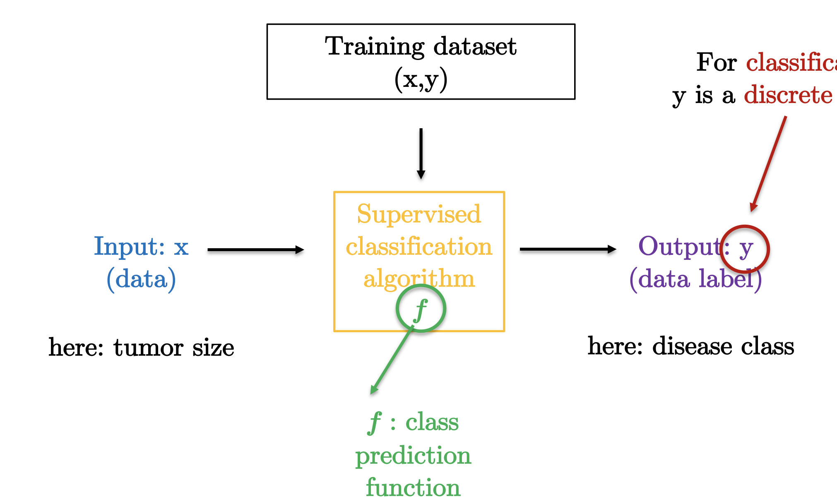
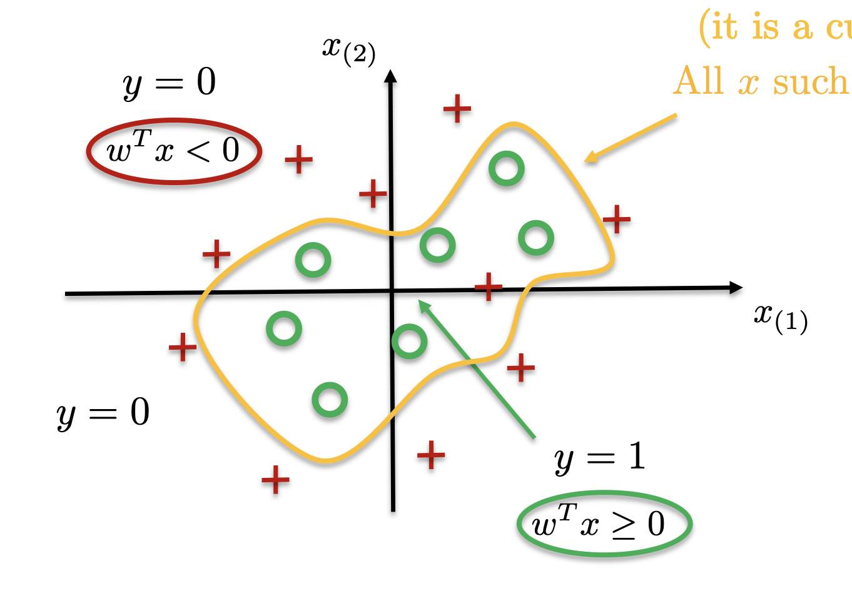
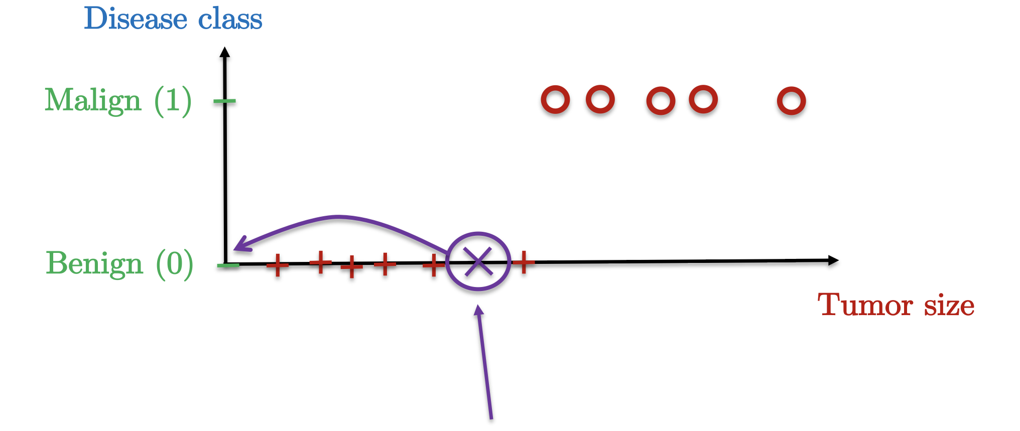
Supervised Classification
Formalization
How Supervised Classification works
How Supervised Classification looks
To predict whether a deal is "good" or "bad", given existing features
Deal classification
Good (1)
Bad (0)
Features (e.g. LTV/CAC)
Is the deal good or bad? Supervised classification predicts it is bad.
Introduction | Deal Sourcing | Deal Scoring | Portfolio Support | Fund Operations | Recommendations

Slide 13
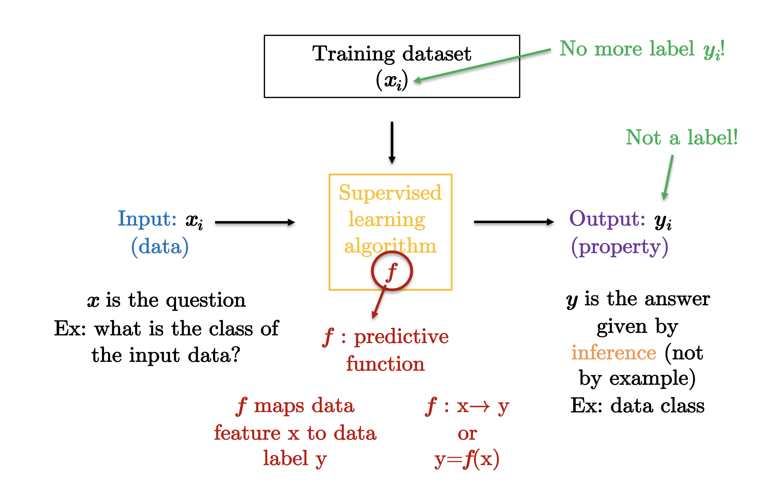
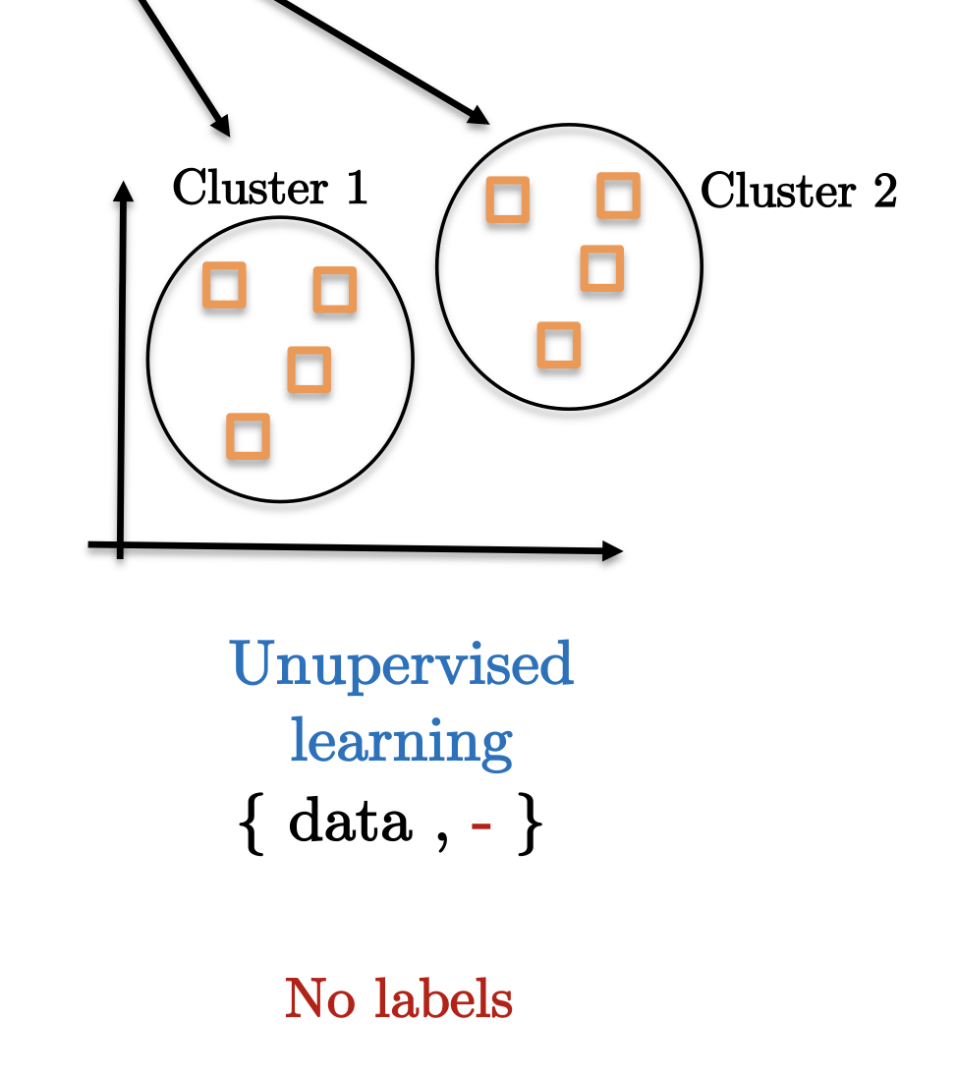
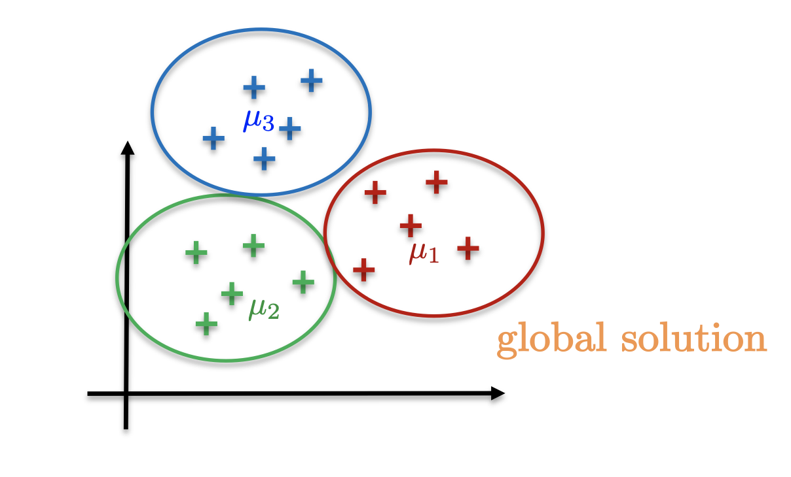
Unsupervised Classification
Design a predictive function given a training set which has no label to find structures in data
How Unsupervised Classification works
How Unsupervised Classification looks
To cluster deals together based on certain features
In this case, there are three different "clusters" of deals
Introduction | Deal Sourcing | Deal Scoring | Portfolio Support | Fund Operations | Recommendations

Slide 14
Evaluation of Data Science and Analytics
Data Science and Analytics can be used in VCs to help analyze deals
However, it requires large sets of data to be effective
Less Applicable for: |  | More Applicable for/on:
Smaller VC firms |  | Larger VC firms |  | Growth / Late stage VCs |  | Late stage start-ups
Less data available to accurately build models |  | Greater economies of scale and number of data points of success metrics for building models, i.e. financial data, MAU, DAU
Thesis:
Unsupervised Classification is more Suitable
Deal analysis is complex and requires large datasets to train Too labour intensive for supervised classification
Can be an effective tool given limited areas to analyse
For example, one can analyse social media statistics to determine a start-up’s social media presence and growth
An assistive tool for human analysts rather than replacing
Data science can be used as an assistive tool to highlight deals with certain success metrics
Introduction | Deal Sourcing | Deal Scoring | Portfolio Support | Fund Operations | Recommendations

Slide 15
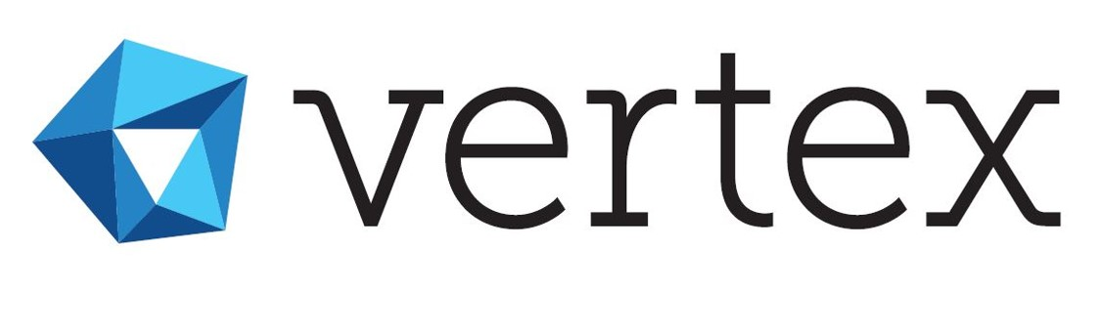
Application for VCs
Case Studies: Vertex Ventures and (VC Firm)
SEA/Worldwide |  | Early and Growth Stage
Makes use of data science technologies like: Web crawling and information aggregation Natural Language Processing, including text categorization, for extracting keywords Classification models using NMF Graph database and analysis and etc
North America |  | Early Stage VC
Built a due diligence bot using: Binary classification of 1 (Good) or 0 (Bad) based on success factors to train bot More accurate in predicting failures as time to failure is much shorter than success Bot rates 1 – 5 based on investment potential
Key Technologies Identified:
Network Analysis |  | Web Crawling |  | Classification Models |  | Natural Language Processing
Data Analytics Solutions
Data Science Solutions
Introduction | Deal Sourcing | Deal Scoring | Portfolio Support | Fund Operations | Recommendations

Slide 16
Data Science and Analytics for Portfolio Support
Notes:
Slide 16:
Moving on, we understand that portfolio support is an aspect where VCs spend most of their time. Therefore, in this section, I’ll be going through how Data Science and Analytics can help in portfolio support.
Next slide please.

Slide 17


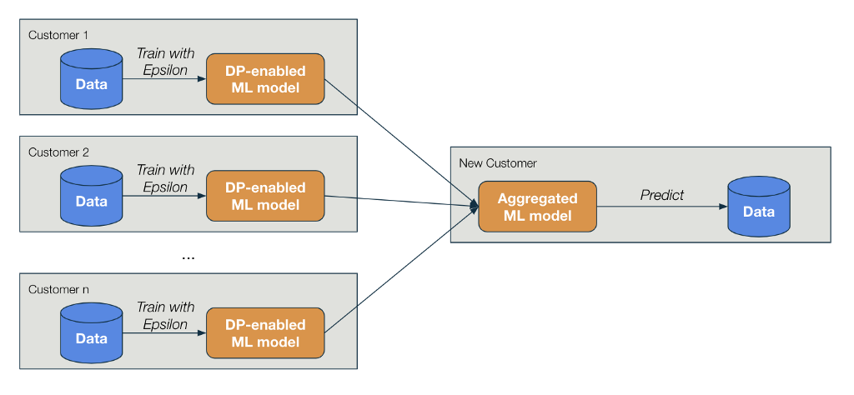

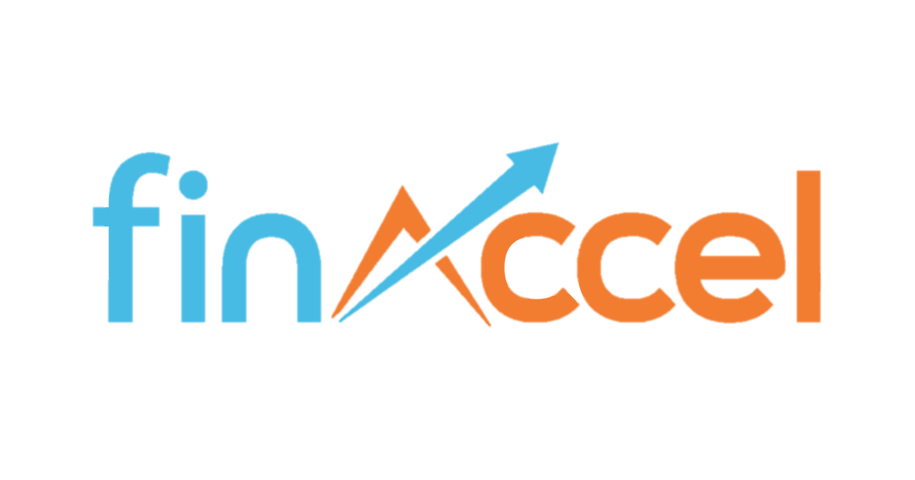
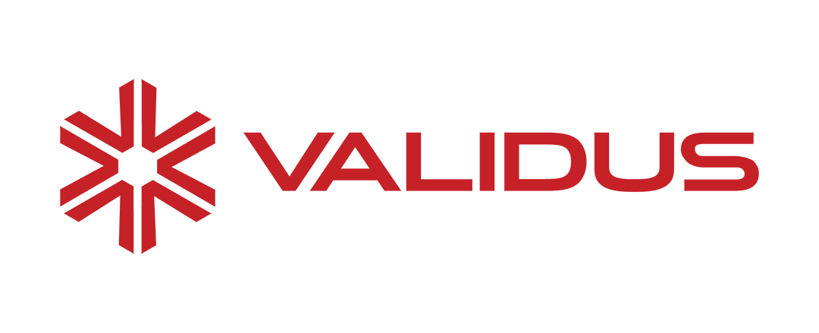

Advising and Assisting Portfolio Companies
Case Studies: Georgian Partners and Openspace Ventures
Georgian Partners
Description
Epsilon enables its portfolio companies to quickly adopt differential privacy methods.
Technology
Description
Working with portfolio companies on recruitment and projects surrounding Data Science & Analytics Advising them on the different models and the approaches
Example of Portfolio Companies
Dr Zhao (OSV): “Data science serves as a differentiating factor for OSV as compared to other funds”
Introduction | Deal Sourcing | Deal Scoring | Portfolio Support | Fundraising | Recommendations
Notes:
Slide 17:
Firstly, some VCs will help their portfolio companies through the most direct manner which is to advise and assist them in Data Science & Analytics projects. Most of the time, these VCs will have a dedicated data science team to do this.
One example would be Georgian Partners.
Georgian Partners developed a suite of software tools, called Epsilon which will allow its portfolio companies to accelerate the pace at which they can roll out and apply Data Science, Machine Learning and AI projects.
Epsilon brings privacy guarantees and enables better data and ML model aggregation.
The other example that I would like to highlight is Openspace Ventures.
As part of our research, our team spoke directly to Dr Zhao Yiliang of Openspace Ventures. To provide some context, he’s the VP of the data science team at OSV.
He mentioned that he was mainly supporting their portcos in terms of recruitment and also helping them directly with their data science and analytics projects.
He explained that usually a company will have a problem they want to solve or outcome they want to achieve using data science and from there, he’ll provide his opinion on the different approaches to take and how they should go about building their data science models.
Some examples of the portfolio companies include Gojek, Finaccel, Validus and Biofourmis.
Next slide please.

Slide 18


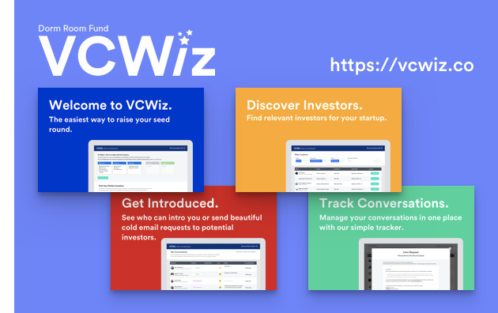
Assisting with Fundraising Rounds
Case Studies: DormRoomFund
Aims to make fundraising a more equitable and straightforward process
Challenges |  | Solutions
Not having any prior relationships with VCs |  | Analyses VC’s social graphs to find mutual connections
Lack of access to relevant VCs |  | Acts as a directory to discover relevant VCs for startups
Challenging to stay abreast of conversations with VCs |  | Central repository to manage the process of reaching out to VCs
1
2
3
Introduction | Deal Sourcing | Deal Scoring | Portfolio Support | Fundraising | Recommendations
Notes:
Slide 18:
Another way for VCs to support their portfolio companies is through fundraising.
In January 2018, Dorm Room Fund launched VCWiz, a tool to help founders find investors and raise money
The platform serves as both a VC directory and a CRM tool
It helps founders find the best introduction path to selected VCs by analysing their social graphs
As a VC directory, this tool pulls information from a variety of sources including Crunchbase, Twitter and others. It uses basic machine learning to recommend investors depending on their bio and preferred industries.
As a CRM tool, it serves as a central repository and includes features such as conversation tracking and email integrations .
Now I’ll hand over to Zhi Zhang to explain more on how data science and analytics can help with competitor analysis and recruitment.

Slide 19

Competitor Analysis and Benchmarking
Case Studies: Signalfire and Social Capital
Beacon Software Suite
Actively tracks more than 2 million data sources and half a trillion data points
Portfolio companies can compare their performance against a collection of comparable companies to get a sense of how well they are performing relative to the market
Capital-as-a-Service Model
Founders submit a questionnaire, revenue figures and other data about their company
If Social Capital likes what it sees, it will invest up to $250,000. If it doesn’t, it will at least deliver feedback to the startup
A set of proprietary algorithms quantitatively assess if the company has achieved product-market fit, and how well it stacks up on core metrics against industry benchmarks
Chris Farmer (Signalfire): “Being massively differentiated from other venture firms and having a totally novel story is very helpful”
Introduction | Deal Sourcing | Deal Scoring | Portfolio Support | Fundraising | Recommendations

Slide 20
Talent Scouting and Hiring
Case Studies: Signalfire
Talent Platform
Executive Recruiting Technical Recruiting Talent Research Recruitment Process Optimization Leadership Development & Mentorship Advisor Network Communities
Beacon Talent Software
Looks at the entire tech industry: over 10M data sources from 6M companies Ranks each employee with quality dimensions and provides real-time predictions on how likely they are to switch jobs, helps portfolio companies with identifying the right recruitment fit
In just 6 months from launching Beacon Talent, it was able to place 55 candidates, a quarter of whom on executive level, in their portfolio companies.
Introduction | Deal Sourcing | Deal Scoring | Portfolio Support | Fundraising | Recommendations

Slide 21
Data Science and Analytics for Fundraising
Notes:
Slide 22: Data Science and Analytics for Fundraising
So Augustine talked a bit about fundraising for startups, but here I will talk more about fundraising specifically for VCs, hence the presentation right.
So before we see how technology can be used in the fundraising process for VCs, we should understand the two main considerations, or basically the pain points. Again, this is just my personal opinion so feel free to correct me.

Slide 22
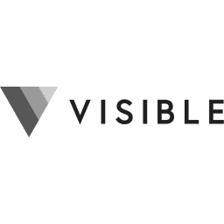

Fundraising Considerations
Currently, there are two major considerations in fundraising for VCs
Sourcing for Investors
Due Diligence Process
Types of LPs
Collect several information into data room
Friends and Family
Rich Individuals
Family Offices
Wealth Managers
Funds of Funds
Endowments
Pension Plans
Sovereign Funds
Fund Information
Organisation Information
Team Information
Market Reports
Investment Strategy / Process
Track Record and Case Studies
Legals and Reference Checks
Where to find LPs?
Websites and Desktop Research
Proprietary Databases (Crunchbase, etc)
Founders, especially old-school founders
Industry and Networking Events
Several commercial solutions are available!
Opportunity for Technology here!
Introduction | Deal Sourcing | Deal Scoring | Portfolio Support | Fundraising | Recommendations
Notes:
Slide 23: Fundraising Considerations
So we have 2 considerations, one is the sourcing for LPs, and the other is the due diligence process. Now the due diligence process is less pressing as there are many solutions out there. There is digify, a data room information management software that many VCs use, and there is also visible, a portfolio tracking and another information management software that some VCs use as well, and you can share relevant portfolio information with LPs that may want to see. This part has been done to death by all the SaaS companies out there so let’s instead zoom in on the other challenge, finding investors.
So finding investors is challenging, especially for first time funds or for funds like PV. Just kidding PV is really big and famous yo. Anyways, so sourcing for investors is always a challenge. People say:
Friends and Family
Rich Individuals
Family Offices
Wealth Managers
Funds of Funds
Endowments
Pension Plans
Sovereign Wealth Funds
But if you’re a new investor, you can forget about 6, 7, and 8. You want to focus on 2 3 4, but how do you even find these individuals. Trust me, its not so simple as just saying google family offices, alot of these UNHW individuals deliberately make it hard to find them online. I was doing some research at TRIVE a long time ago on family offices and I tell you family offices are damned hard to find through just desktop research alone. So, instead of the traditional forms of finding investors, we can now incorporate data science to speed up or accentuate fundraising.

Slide 23
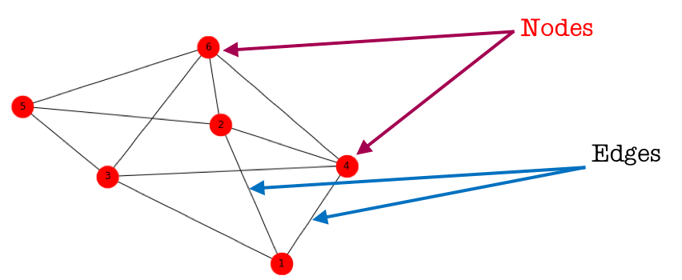

Sourcing for Investors
Network Analysis can be used to reveal new potential connections or LPs that were unknown
How Network Analysis Works
Investigates relationships between entities, i.e. between different VCs and startups, and investments between them
Packages such as networkx for python help identify groups
How Network Analysis can be used here: (Just 1 Suggestion)
Network Analysis
Databases such as Crunchbase
Unsupervised Learning
Find New LPs and investments
Other Uses of Network Analysis
Case Study: Affinity VC
Deal sourcing for startups
Relationship building between VCs
Helping startups fundraise too
Relationship Management Software
Introduction | Deal Sourcing | Deal Scoring | Portfolio Support | Fundraising | Recommendations
Notes:
Slide 23: Network Analysis
So how do we do so? We use network analysis to source for investors.
How does this chart work?
It has the nodes and the edges.
Nodes: Represent objects we are going to analyze, aka the people
Edges: Relationships between two people, aka say if Sequoia invests in Startup A, the link is the investments between the two
So you can map an entire network representing a whole ecosystem of different investors, VCs and startups, and the relationships between them. You have quite a few simple packages that can do this like networkx to build the network and then you can just plot with matplotlib, being overly simplistic here but just giving a rough idea of it.
1 suggestion is to combine network analysis with web scraping, you can scrap the connections of each person in PV, throw them as nodes into the model, throw some unsupervised learning and find connections of each person to other people and potentially find investors in between. Again, this is a gross oversimplification but I was previously working on a model, and if I ever do finish it I will share with you all.
Another suggestion is to download crunchbase databases of investors and startups, throw them into the networkx model, and set the relationships to be the investments, and find LPs that are co-investors themselves, as they would be more open to investing in VCs.
So other than fundraising, network analysis is also used in other forms, such as as mentioned, helping startups, and also deal sourcing, and relationship management. In particular, we see the case study of affinity VC, and I’m sure many people have seen the ads around on linkedin, but affinity VC probably uses the same technologies in graphing your networks, or as they call it, alliances, in order to find new leads.

Slide 24
Conclusions
Notes:
Slide 24: Conclusion
Ok, so we are now at the conclusion.

Slide 25



General Thoughts and Recommendations
The Later stage the fund, the more technology becomes viable and accessible
Data science and analytics is a complement, not a replacement to analysts
At this stage, data science remains expensive or time-consuming for most funds
1
2
3
Early Stage
Later Stage
However, there are some free solutions that some VCs can consider incorporating
Viability
However, funds that can blend data science and analytics into their operations can differentiate themselves and prepare them for better success, be it deal flow generation or achieving uprounds
Recommendations for Protégé Ventures
A special projects team can work on projects such as network graphs, classification models and others
Possible to invest in an information management system, given current systems
Value add to potential and portfolio startups through data mining and providing benchmarks to startups
1
2
3
Introduction | Deal Sourcing | Deal Scoring | Portfolio Support | Fundraising | Recommendations
Notes:
Slide 25: General Thoughts and Recommendations
The later stage the fund, the more the technology becomes viable and accessible, you have data points as mentioned right, and you have more money to burn, and bigger deals
Technology is a complement not a replacement, technology fucking sucks as a standalone, its way too unreliable, but it can point to patterns that humans fail to see
At this stage, data science remains expensive or time consuming for most funds, especially those that only have a team of maximum of 10 full-time people (I count the intern army firms like GGV or TRIVE in this), as compared with OSV or vertex that’s staffed with like 30-40+ full timers people. However, python packages and coding is free so if you have some experience you can consider experimenting with some projects
Funds that have the money to burn on such shit of course will reap better results and rewards but that is the nature right, the more money you have the more likely you are to succeed, same shit in VC
With that being said, here are some recommendations for PV:
A special projects team can be devised to work on random coding projects during the school sem on like projects such as classification models
Possible to invest in an information management system, unless you guys have one and I’m not aware of, given that I’m only aware of airtable
We can value add to potential startups. Like it doesnt make sense, we have like 50 analysts and associates, and quite a few technical people, so we could definitely do something there, like collecting data points and passing reports to our startups. I think being a student fund theres a lot of opportunity for collaboration between us and our portfolio startups and we should be more active instead of just being passive investors. That will also help get the PV name out even more.

Slide 26
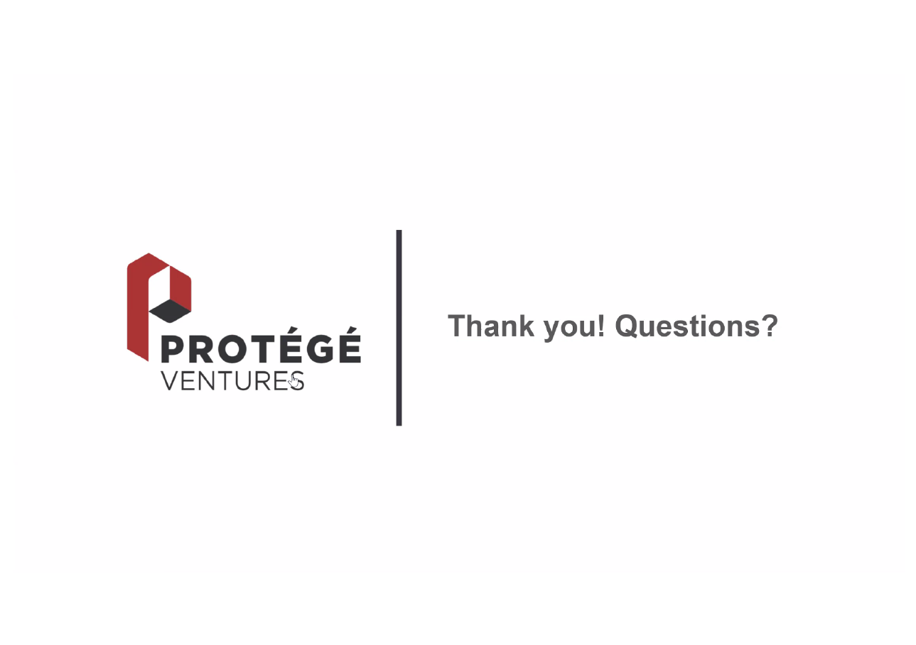

Slide 27
References
https://www.mckinsey.com/industries/technology-media-and-telecommunications/our-insights/a-machine-learning-approach-to-venture-capital#
https://techcrunch.com/2019/06/26/vcs-double-down-on-data-driven-investment-models/
https://medium.com/@IamRavijot/rise-of-intelligent-and-data-driven-venture-investing-36edad1d4b85
https://medium.com/connetic-ventures/singles-or-home-runs-how-we-train-our-ai-early-stage-investing-vc-bot-69e03bb1723c
https://medium.com/@georgianprtnrs
https://en.wikipedia.org/wiki/Dorm_Room_Fund
https://medium.com/hackernoon/winning-by-eating-their-own-dogs-food-83-venture-capital-firms-using-data-ai-proprietary-da92b81b85ef
https://vcpreneur.com/how-vcs-lps-apply-data-science-to-make-informed-investment-decisions-527c917a3edf
https://www.startupreporter.eu/how-does-a-venture-capital-fund-work-in-terms-of-operations/
https://www.codingvc.com/behind-the-scenes-at-a-vc-fund-part-2-helping-founders-and-time-allocation/
https://corporatefinanceinstitute.com/resources/careers/jobs/role-of-investor-relations-ir/
https://towardsdatascience.com/data-science-in-venture-capital-8c13ec0c8458
https://towardsdatascience.com/social-network-analysis-in-venture-capital-4db03cb5d833
https://www.venturecapitaljournal.com/south-east-asia-still-has-goldmine-potential-for-lps/
https://pearonline.com/a-checklist-for-producing-a-great-fundraising-data-room/
https://www.docsend.com/blog/how-first-time-funds-attract-lp-investments/
https://digify.com/case-studies/cocoon-capital-raised-over-21-million-with-digify/
https://runway.is/blog/how-to-raise-a-vc-fund/
https://medium.com/initialized-capital/how-to-raise-a-venture-fund-735647ca90aa
https://towardsdatascience.com/how-to-get-started-with-social-network-analysis-6d527685d374
https://towardsdatascience.com/network-analysis-d734cd7270f8

